Slide 1
Software Design and Architecture
Somphon Rueangsri 60090035

Slide 2
Pattern focus design pattern

Slide 3
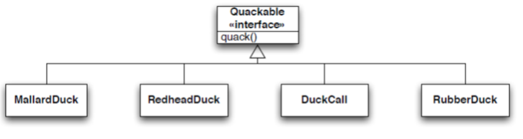
Step one : we create Interface to avoid coding to implementation.
All animal that are quackable can implement function quack by using interface.

Slide 4
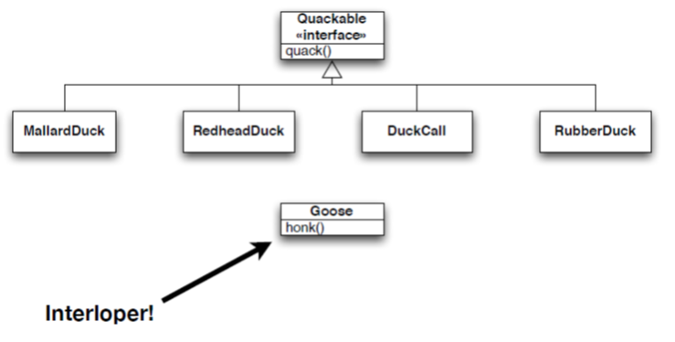
Step 2: Need participant.
Here the animal that can not quack can exist as the participant.
This allow you to add another class of animal that does not implement quackable. Thus you can add many different kind of animals.

Slide 5
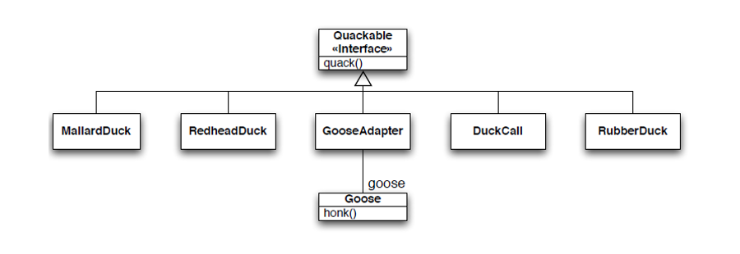
Step 3: Add adapter
Although goose is not a duck, we can make the goose as adapter and implement the function quack but when the function quack is called Goose use honk instead of quack, this adapter allow the creation of different kind of animal and pretends that there are quackable.

Slide 6
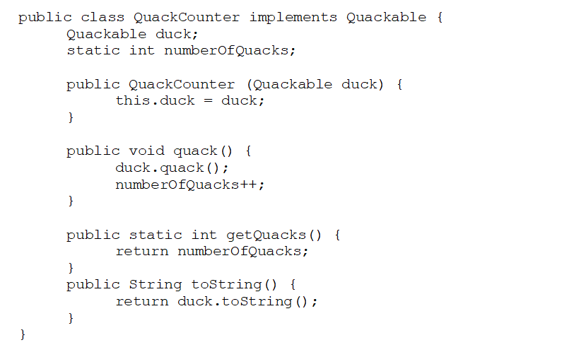
Step 4: use decorator
By using QuackCounter class which is the decorator, implementing the quackable. Quack Counter keep track on number of quack per duck, each time when the duck quack it store number of quack in variable name numberOf Quacks.

Slide 7
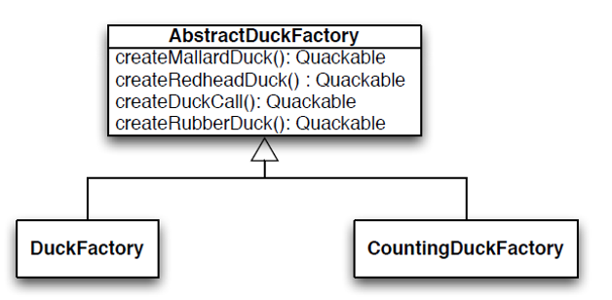
Step 5: factory
Here we use factory to create object duck which will give the basic feature of interface. When you add new object you can add without changing anything in the factory class . This also follows Solid principal of programming.

Slide 8
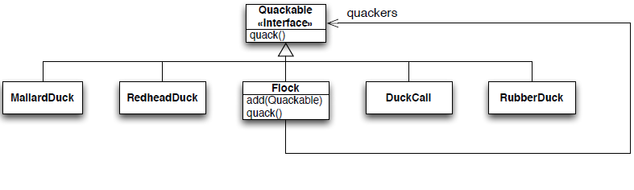
Step 6 : add support for flock with composite
Here the class flock implement quackable this flock is having a function add(Quackable) which will store quackable in an arraylist this is use when you have composition or group of object.

Slide 9
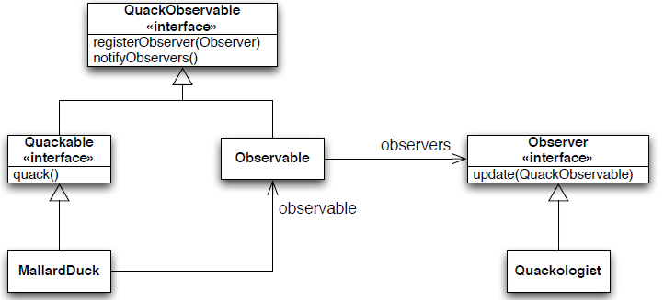
Step 7: Add observer
Here we add observer pattern to keep track of quack. Each time when the duck quack it notify the observer that the duck has quack. It also avoid the duplicate of code.

Slide 10
Task 2: Object Relational Mapping

Slide 11
What is ORM.
ORM is Object-relational-mapping is the idea of being able to write queries like the one above, as well as much more complicated ones, using the object-oriented paradigm of your preferred programming language.

Slide 12
Advantage.
If you are a master at SQL, you can probably get more performant queries by writing them yourself.
As a developer, it is important to understand what is happening under the hood. Since ORMs can serve as a crutch to avoid understanding databases and SQL, it can make you a weaker developer in that portion of the stack.

Slide 13
What is JPA.
The Java Persistence API (JPA) is a Java specification for accessing, persisting, and managing data between Java objects / classes and a relational database. JPA was defined as part of the EJB 3.0 specification as a replacement for the EJB 2 CMP Entity Beans specification

Slide 14
Advantage
JPA data is represented by classes and objects rather than by tables and records as in JDBC. Using plain old Java objects (POJO) to represent persistent data can significantly simplify database programming.
You can quickly switch your JPA implementation, as long as you’re not using any proprietary features.
The different implementations can add additional features to innovate faster than the standard. Some of them might become part of the specification at a later point in time.

